Slide 1
Standing on the Shoulders of Giants
PowerShell Solutions for SQL Server
Chrissy LeMaire, MVP, DBA
Constantine Kokkinos, DBA
Rob Sewell, MVP, DBA

Slide 5

Chrissy LeMaire
SQL Data Pro – Since 1999
DBA, Developer and Architect
PowerShell MVP – Since 2015
Most PowerShell work revolves around SQL Server with a bit of VMware & SharePoint
Sr. Systems Engineer
GDIT @ NATO Special Ops HQ
Best Speaker & Best Lightning Talk - #SqlSatDublin
Best Speaker with dbatools teammate Rob Sewell
/in/chrissylemaire
@cl
netnerds.net

Slide 6

Constantine Kokkinos
Khimera Data LLC
SQL Server Automation, Performance, and End-to-End Consulting
Apple Certified Trainer
Taught Apple Techs for years and runs PowerShell on his MacBook Pro.
Founder, Khimera Data LLC
dbatools bug fixer and git merger extraordinaire
/in/ckokkinos
@mobileck
Let me know if you want to get your first pull request done and have any questions!
constantinekokkinos.com

Slide 7

Rob Sewell
Sewells Consulting Limited
PowerShell Automator, PowerShell Trainer, Database DevOps
MVP, Speaker and Organizer
Half a Best Speaker!!, PowerShell and SQL user groups, national and international events
Consultant, Sewells Consulting Ltd
dbatools dbareports SQLDiagAPI
/in/robsewellsqldba
@sqldbawithbeard
Loves Pester. Always available for help via the usual social media channels
robsewell.info
Notes:
This is Rob He runs his own company providing PowerShell magic, PowerShell Training and Database DevOps consultancy he’s a speaker and organiser for SQL South West, SQL Saturday Exeter, PSDayUK, PSConf.eu, PSConfasia and conference volunteer at SQL Bits

Slide 8



Lab Proctors
Shawn Melton
SQL Server DBA, Pythian
Sander Stad
SQL Server DBA, Waypoint Analytical
Brandon Abshire
SQL Server DBA, Sharp HealthCare

Slide 9

Join our private pre-con channel
Invite yourself to Slack
dbatools.io/slack
Message @wsmelton, @sqlstad or @scinobe
They’ll invite you to #dbatools-precon
Ask questions and get answers in real time!

Slide 10

Update your modules!
Update-Module dbatools, summitlab
Import-Module dbatools, summitlab -Force

Slide 11
Agenda, before lunch
What we are aiming to solve
PowerShell Orientation
Condensed SQL PowerShell history
PowerShell Syntax ≈ T-SQL
Benefits of PowerShell and when to use vs. T-SQL
Remoting & security
Pester ❤️ SQL Server

Slide 12
Agenda, after lunch
Get-Started on your PowerShell Journey
Intro to dbatools
Lab with migration and Pester tests
PowerShell & SQL Server Agent
dbatools development in practice
The story of Get-DbaRestoreHistory
dbatools team lessons learned
Questions

Slide 13
Problems we’re aiming to solve
Reduce Hesitations about PowerShell
Increase Confidence about Script Development
Whether it’s about security concerns or feeling like PowerShell is too different or hard
You’ve got a whole community that’s excited to help!
Encourage Community Contributions
Encourage Best Practices
Join Microsoft and the community in the global open source movement
Things we wish we knew years ago, all condensed
Notes:
EACH OF US TAKE ONE

Slide 14
Orientation

Slide 15
SQL PowerShell History
(Condensed)

Slide 16
Condensed SQL PowerShell history
First Release - SQL Server 2008
5 commands + Provider
Snapin and Minishell
SQL Server 2012
33 commands
Module
SQL Server 2014
45 commands
Notes:
2008 – PowerShell Snapin and Minishell
2012 – introduced the SQLPS module
44 Months
Mostly Availability Group
2014 - 6 years into it and we’ve only got 45 commands

Slide 17
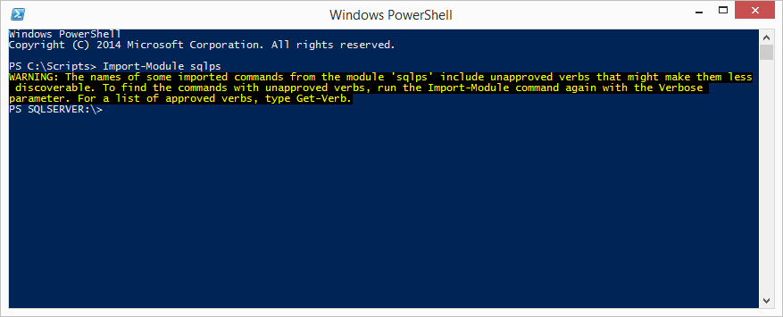
Condensed SQL PowerShell History
Notes:
Tab-completion didn’t work
Invoke-SqlCmd was buggy
-WhatIf actually performed commands
SQLPS was slow to load
SQLPS changed the directory unexpectedly
SQLPS used unapproved verbs
Other platforms offered 700+ cmdlets

Slide 18

Condensed SQL PowerShell history
SQL Server 2016, 2017 and Beyond
A new name
Dedicated engineer
Now separate from SSMS install
PowerShell Gallery
Continuous releases
Currently at 98 cmdlets
Notes:
Toy Story Reference ☺
The SQL Server team hired a dedicated PowerShell engineer – We love Matteo – even if we aren’t sure how to pronounce his surname
Microsoft began taking Connect Items (suggestions + bug reports) seriously
https://social.msdn.microsoft.com/Forums/en-US/728f562f-0600-432b-aaab-1decc406d6d8/submitting-defect-reports-and-suggestions?forum=sqltools
SQLPS was renamed to SqlServer
Made it easier to do REGULAR RELEASES!
Initially these were monthly releases associated with SSMS
But then they were doing two a month of SSMS
March 2017 - Separated from SSMS install with the SSMS 17.0 release and available from the PowerShell Gallery – no need for massive download (20Mb versus 700Mb ) and quicker releases –easier to update
Rob, discuss how community and Microsoft came together

Slide 19
PowerShell Syntax
PowerShell ≈ T-SQL
Notes:
Should be fu nctionality?

Slide 20
Querying
T-SQL
PowerShell
SELECT
FROM
JOIN
WHERE
GROUP BY
ORDER BY
Select-Object
Piping or looping
Join-Object
Where-Object
Group-Object
Sort-Object
Notes:
So breaking down the basics, here’s the list.
What when we go by the shortnames, its may be even clearer.

Slide 21
Aliases
T-SQL
PowerShell
SELECT
FROM
JOIN
WHERE
GROUP BY
ORDER BY
select
| or %
join
where or ?
group
sort
Notes:
So we can see that order by and from are a little bit wonky, but otherwise this is somewhat familiar territory.
And that’s what I want you all to understand, that your set based filtering and projections are welcome and awesome skills, and they apply fairly directly to things in PowerShell.
T-SQL has AS, we have Set-Alias
Address RBAR with PS (% = ForEach-Object) and how it’s NBD

Slide 22
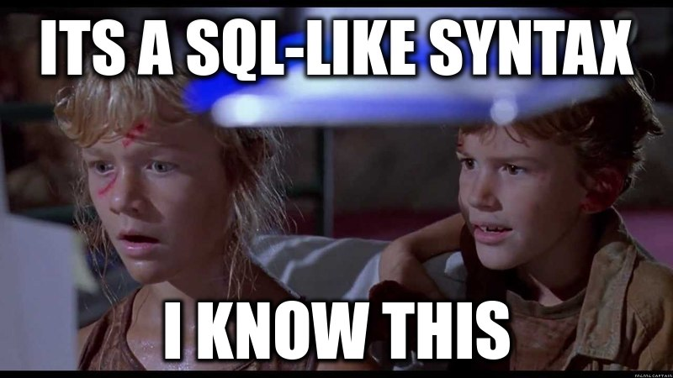
Powers you already know
Notes:
Remember, it’s a SQL like syntax, you know this.
Alright, let’s dive into the various commands, break them down a little bit, and show off some interesting possibilities.
First, we are going to discuss Select-object

Slide 23
Select-Object
# Get me the default output
$db
# Get me everything!
$db | Select-Object *
# Informal, select one property
$db | Select Name
# Prim and Proper, select a property using named parameters
$db | Select-Object -Property Name, Size
# Sometimes avoiding the pipe can be faster, check for -InputObject
Select-Object -InputObject $db -Property Name
Notes:
So select-object’s syntax (if you are new to powershell) can be a little daunting, but the truth is that most things in powershell follow a set of rules, and there are are always wonderful examples in the help documentation ☺
Select-Object or Select for short can filter and project properties from objects and pass whole objects or portions through the pipeline for you to further manipulate.
Just like a SQL statement, you specify a list of “columns” or properties, and those will be returned.
Unlike a SQL Statement, the Select-Object command does not allow things like formatting directly in the selection stage without a little additional trickery.

Slide 24
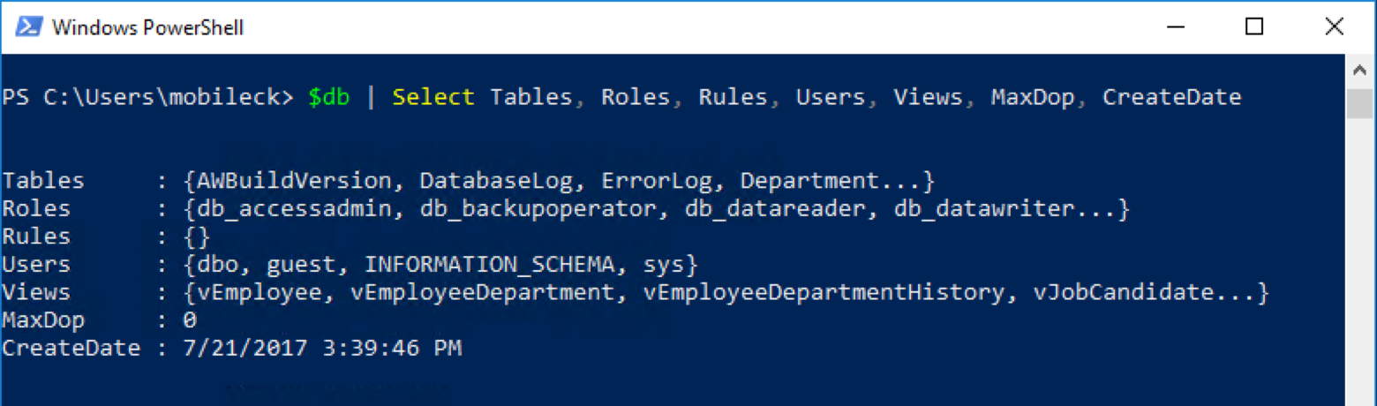
Select-Object
Notes:
One thing you will find repeated in our sessions is that things that would be generally a bad idea either difficult in writing, composing, maintaining, or at the very least or at least performance inhibiting in T-SQL may not be a bad idea in PowerShell and visa-versa.
You can see in this command piping the database object to Select-Object we get a set of objects which would not be nearly as clear to get at in the TSQL versions, and would require a decent amount of additional code (this is 2016, so MaxDop is on the database level)
The Select-Object cmdlet has the ability to automatically understand the length of every object and it is trivial to index a specific position in a list, which would often require keys or row numbering in TSQL.
Using a combination of –First, -Skip (which skips the first N records) and –Last, you can easily sample your results and make sure they are what you expect, or even use the –Index parameter to give a list of items you would like extracted.
Also unlike TSQL, PowerShell often has complex nested types (if you do this in SQL son I feel bad for you, denormalize or get out) and the –ExpandProperty parameter is a really nice way to automatically extract the contents of nested collections or in some cases when a property is returned instead of a value.
This is a common operation when you want to dynamically get the value of something that returns an object instead of a value, simply select expanding and you don’t have to do some complex assignment dance.
One thing that I think is worth explaining which is frankly a bit easier in T-SQL than PowerShell is calculated properties, similar to concatenation or additional functions run on projected data in T-SQL.

Slide 25
Select-Object
-First
-Skip
-Last
-Index
-ExpandProperty
Calculated Properties
Notes:
One thing you will find repeated in our sessions is that things that would be generally a bad idea or at least performance inhibiting in T-SQL may not be a bad idea in PowerShell and visa-versa.
The Select-Object cmdlet has the ability to automatically understand the length of every object and it is trivial to index a specific position in a list, which would often require keys or row numbering in TSQL.
Using a combination of –First, -Skip (which skips the first N records) and –Last, you can easily sample your results and make sure they are what you expect, or even use the –Index parameter to give a list of items you would like extracted.
Also unlike TSQL, PowerShell often has complex nested types (if you do this in SQL son I feel bad for you, denormalize or get out) and the –ExpandProperty parameter is a really nice way to automatically extract the contents of nested collections or in some cases when a property is returned instead of a value.
This is a common operation when you want to dynamically get the value of something that returns an object instead of a value, simply select expanding and you don’t have to do some complex assignment dance.
One thing that I think is worth explaining which is frankly a bit easier in T-SQL than PowerShell is calculated properties, similar to concatenation or additional functions run on projected data in T-SQL.

Slide 26
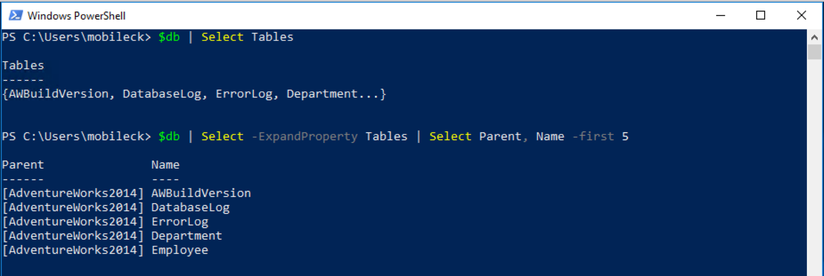
Select-Object -ExpandProperty
Notes:
One thing you will find repeated in our sessions is that things that would be generally a bad idea either difficult in writing, composing, maintaining, or at the very least or at least performance inhibiting in T-SQL may not be a bad idea in PowerShell and visa-versa.
You can see in this command piping the database object to Select-Object we get a set of objects which would not be nearly as clear to get at in the TSQL versions, and would require a decent amount of additional code (this is 2016, so MaxDop is on the database level)
The Select-Object cmdlet has the ability to automatically understand the length of every object and it is trivial to index a specific position in a list, which would often require keys or row numbering in TSQL.
Using a combination of –First, -Skip (which skips the first N records) and –Last, you can easily sample your results and make sure they are what you expect, or even use the –Index parameter to give a list of items you would like extracted.
Also unlike TSQL, PowerShell often has complex nested types (if you do this in SQL son I feel bad for you, denormalize or get out) and the –ExpandProperty parameter is a really nice way to automatically extract the contents of nested collections or in some cases when a property is returned instead of a value.
This is a common operation when you want to dynamically get the value of something that returns an object instead of a value, simply select expanding and you don’t have to do some complex assignment dance.
One thing that I think is worth explaining which is frankly a bit easier in T-SQL than PowerShell is calculated properties, similar to concatenation or additional functions run on projected data in T-SQL.

Slide 27
Calculated properties
$login | Select-Object -Property Name + “test” # This fails.
# Technically would work but kludgy
($login | Select-Object -ExpandProperty Name) + "test"
$login | Select-Object -Property Name, @{
# Specify your column's name
Name = "Formatted Column";
# Takes a script block to evaluate
Expression = { " $($_.Name) test" };
} # Idiomatic
Notes:
The first example is something I did a lot when I started in PowerShell, and it’s because I was missing the fundamental concepts.
The property name isn’t itself a thing, just a list being put into another function, and that function has a special syntax if you want to dynamically modify its output.
SO
Specifically, you have to pass a hash table with specific values, and the Select-Object command will understand you have to use a Calculated Property.
You can do this with any values you want, so if you find yourself saying “I need to join this” consider for smallish sets a calculated property could even be a lookup into another object, it’s a ScriptBlock so the possibilities are almost endless.
Alright, so we have a vague notion of how to take an object, find its properties, use select-object, project some of those properties, and we can even format it to boot.
What we haven’t really talked about is that little vertical line up there, called the pipe.

Slide 28
Piping -or looping
$db | Select-Object * # Pass $db output to the Select-Object command, you can use anything but the format- commands multiple times
$db | ForEach-Object { $_ } # and foreach item, return the database
$db | % { $_ } # same as above
foreach ($db in $databases) { $db } # same as above
while ($condition) {} # While Boolean condition do ScriptBlock
for ($i=0; $i -le 100; $i++) { $i } #0-99 display $i and increment it
do { $i } while ($condition) # Do while $condition is $true
do { $i } until ($condition) # Do until $condition is $true, I usually avoid this one.
Notes:
Piping and looping are next up on the docket, and they basically replace the FROM idiom in T-SQL.
Effectively, if you want to operate on an object in a general way to project and filter data, you will generally be using one of these approaches (though C# does allow further interesting options not listed here.)
In piping, we pass the output of objects into the inputs of commands, and the pipe has some rules we will talk about later which automagically connect the dots of how; the pipe also allows any number of select/where/etc in the pipeline, just like you can subquery infinitely in a SQL statement (though in both cases you might be faffing a bit.)
With looping (which if you’ve written most other languages this will be review time) in Powershell you can pipe the object to a foreach, write an explicit foreach, or use one of the provided loops.
For most dba related tasks I find foreach to be my favorite non pipe based loop, but its really user’s choice.
We wont spend much more time on these except to talk about the piping rules (in case you have a command through a tiz on you)

Slide 29
Pipe rules
How does Stop-Process know?
Get-Process -Name powershell | Stop-Process -WhatIf
Parameter Binding
Bind parameter by Value with same Type (No Coercion)
Bind parameter by PropertyName with same Type (No Coercion)
Bind parameter by Value with type conversion (Coercion)
Bind parameter by PropertyName with type conversion (Coercion)
Thanks Boe Prox!
https://mcpmag.com/articles/2015/05/20/functions-that-support-the-pipeline.aspx
Notes:
PowerShell actually has pararmeter binding rules which determine how the output of one command or object is read by the input of a second.
I totally stole this list from Boe Prox, who is a wizard of powershell such that I fear speak his name, please buy his book.
Summed up, the output of Get-Process –name powershell looks like a bunch of values with various column headers, and the object has the type of [System.Diagnostics.Process]
PowerShell takes a look and see’s the output of that object matches the first parameter input of the Stop-Process command with the –InputObject validating the Process[] type, if you want to check this out you can use the Trace-Command cmdlet and look for the ParameterBinding Information call, you should see bind arg [System.Diagnostics.Process[]] to param [InputObject] Successful.
These rules are not things you need every single day, especially when working with a well designed module like dbatools.
If your functions are “advanced functions” and support the pipeline, and have sane input and output object types, you will find that powershell mostly automagically figures it out for you.
If you get really stuck trying to pipe things or are getting some confusing output, keep the previous rules in mind and pipe your object to Get-Member.

Slide 30
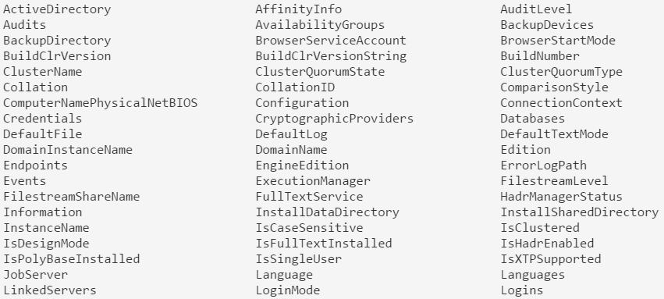
Get-Member introspection
Connect-DbaSqlServer -SqlInstance localhost | Get-Member -MemberType Properties | Format-Wide -Column 3
Notes:
It’s the automatic “Tell me what this thing does” tool of powershell, and its invaluable when navigating unfamiliar territory with PowerShell.
In general, Methods are things the object does (verbs) and Properties of various types are things the object is (data).
Here you see my asking the object that is returned from Connect-DbaSqlSedrver “What properties do you have formatted in 3 columns?”
It may seem a bit daunting at first, but when you consider that this is the server object that SSMS does all its work through, it starts to make sense.
You might see some interesting ones, like Databases, Paths, IsSingleUser, Credentials, all sorts of fun properties to be able to immediately inspect!
With this tool in mind many times the answer may be obvious when you are trying to solve a problem (or at least its clear what the next step to unravel the puzzle is) but you might want to just check out the MSDN page on that .NET type to get some additional information if you are getting thrown for a loop.
Many of the times the PowerShell documentation is good, but with some basic PS knowledge you can take a look at the properties and methods of the .NET type, and often times they have decent examples right up front (many if not in PowerShell, at least in C#.)
Alright, moving back onto the train, let’s take a look at Join-Object.
____
This slide also outlines something awesome about PowerShell that drove me crazy with VBScript. Like $sql, this command spans more than one line.
Using escape ` can also allow you to span more than one line by literally escaping a \r\n

Slide 31
Join-Object
Wait, What?
No native Join-Object.
Compare-Object is good, but doesn’t suit.
PowerShell types are messy.
SQL Server is insanely good at this.
Notes:
Wait, Join-Object?
Sorry, there is no native join object in PowerShell.
The truth is, while there are definitely even MSDN blog posts with a Join-Object function, that the idea of Join-Object is a bit… odd in object oriented land.
If you want to do intersection or comparison in powershell, you can use the Compare-Object command and it will output a list of objects that are different. Nonetheless, these object types and values don’t really map directly in the way we expect, and if you treat powershell output like knitting together tables, you are going to have to do some mental gymnastics to get them to work.
This is one of the places where you have to let go of some of the table data structures you and I are so used to, and start to become accustomed to the things that powershell does best.
There are some good tools for bulk loading data in and out of SQL Server (like the .NET dataset) which you might think have strong join semantics, but the truth is that these are thought of with SQL Server in mind, and scaling out joins to the middle tier is fairly rare.

Slide 32
Where-Object
$servers | Where-Object {
$PsItem.Databases -Contains ‘AdventureWorks'
} # Current item in pipeline like A wildcard
$servers | Where-Object {
$_.ClusterName -like ‘sql01*’ -or $_.ClusterName -like ‘sql-01*’
} # -and like wildcard B, chain all you want.
$servers | Where-Object {
$PsItem.Databases.Count –gt 10 -or $_.Logins.Count –gt 10
} # Using $PsItem or $_ is interchangeable >= ps3.0
Notes:
Where-object is the predicate filter for PowerShell, and you can use it to great effect.
Just like TSQL
This would be a good place to talk about fancy quotes and regular quotes and how PS recognizes both
“Databases” is a rich object. How does it contain “Contain?” ToString()!

Slide 33
PowerShell operators
Think parameters
-Contains
-In
-Is
-EQ
-GE
-GT
-LT
-Like
-Match
-NE
-IsNot
-NotContains
-NotIn
-NotLike
-NotMatch
-And
-Or
-Not
Notes:
PowerShell does not use mathematical operators you are used to in the context of comparisons, it does for assignment.
That’s because classic comparison operators like greater than or less than are actually classic shortcuts for shell redirection operators, and so when PS was conceived they thought that as operators were effectively parameters to a function, why not just make it prefixed with –
This also helps a little bit with readability of some code, its much harder to mistake –gt for –lt than < for > in my experience.
The is/isnot compares types
The like compares wildcard comparisons
The match uses regex
Everything else seems pretty straightforward, and you can string them together with –and –or and –not, use parens
Again, you can use where multiple times in a pipeline, so if you want to filter, pipe to a command, and filter, feel free to.
With the where clause mostly cleared away, let’s take a look at Group-Object.

Slide 34
Group-Object
# Return Database counts grouped by Owner. Get-DbaDatabase . | Group-Object -Property Owner
# Return database counts grouped by Compatibility Level.
Get-DbaDatabase . | Group CompatibilityLevel
-- Group-Object is somewhat equivalent to
select col as Name, COUNT(col) as Count, AllColumValuesAsXML
FROM tbl
group by col
-- But works on objects
Notes:
Group-Object is a nice tool in the PowerShell toolbox, but unlike the T-SQL version, its not a 100% critical tool for getting information as PowerShell can determine a lot of aggregate values in loops which would generally be a bad idea in T-SQL.
Here we can see some process grouping, and this is my preferred way to use Group-Object, which is to take some output which may have many rows and quickly categorize them for me and aggregate by various types.
You can think of this somewhat analogous to the following TSQL query, but because it’s not constrained by the same rules as TSQL, it actually returns a 3rd column named Group which actually contains objects which are the counted results. You’d have to do some disgusting TSQL XML querying to get the same result of a column.

Slide 35
Sort-Object
# Default sorting of jobs, pretty meh
Get-DbaAgentJob . | Sort-Object
# Get most recent ran jobs first
Get-DbaAgentJob . | Sort-Object -Property LastRunDate -Descending
# Guess what this will do?
Get-DbaAgentJob . | Sort-Object OwnerLoginName -Unique
Notes:
Sort-Object is a nice little item to sort your objects, but you need to be careful because just like Group-Object, at first it may remind you of T-SQL commands, but it obeys a completely different set of rules.
By default sort-object has a little powershell magic (based on the same formatting files) to determine what it will sort on, but being explicit is always better than implicit when it comes to maintaining code.
There are a few parameters which we would recognize from the t-sql realm that we will check in a second, but I want to caution you that when naively writing sort code, things are not always what you expect.
For instance, what do you think the third command does?
(it returns a single line for each agent job by returning it as the first item in how its lists the processes out in the previous pipeline, output is bizarre for useful stuff, but this is programming damnit, not useful stuff!)

Slide 36
Finish line: console behaviors
Properties may be truncated
Properties re-arranged from your expectations
Total count of properties displayed change
Output you expect missing
Output in an unexpected order
Output mixed with other colors, warnings, errors, debug messages, etc.
Notes:
When new to powershell (or even not new tbqh) you may run into some stuff behaving oddly in your powershell.
What you need to know is a little deeper into how powershell goes from code to displayed on the screen.

Slide 37
Console behaviors
Streams – Host, Output, Verbose, Error, Warning…
Console Host
Console Size
Object Properties Projected
PowerShell Version
*.format.ps1xml
Notes:
When new to powershell (or even not new tbqh) you may run into some stuff behaving oddly in your sessionm.
What you need to know is a little deeper into how powershell goes from code to displayed on the screen.
Talk about each influence a bit.
In many cases, this the type of behavior that can cause interesting results you may not expect.
Depending on the streams, the size of the console host, how the host is implemented, the format files, the powershell version, and the properties and their types you output, you can have a very different experience.
I have written code in PS in the ISE, the console, and visual studio code and seen the output come out three different ways.
Knowing that, keep in mind you can always force behaviors you want, it just may take more effort than you are used to in other languages.

Slide 38
Forcing output
# When you write:
$Output = "A simple sentence."
Write-Output $Output
# It’s really more like:
$Output = "A simple sentence."
Write-Output $Output | Out-Default | Out-Host
# When you are not interested in any junk.
$Error[0] | select * | Format-List -Force
Notes:
If you want to force an object to output (instead of being potentially unioned) you may have to pipe it to Out-Default.
If you are really sick of this formatting bull crap, just use the select * | fl -force magic I love so much (great for error messages)
If you cant get the output with these two tricks, try beginning assigning the output of operations to variables (or $null if you don’t care about the output), there are some cases where object output destroys the console output.
And with that, we wrapped up our talk on PowerShell console quirks, you should be more ready now to take on output from dbatools commands and craft them to your needs!
Awesome.

Slide 39
Bonus: SQL Variables in PowerShell
$sql = "SELECT SERVERPROPERTY('MachineName') AS ComputerName,
ISNULL(SERVERPROPERTY('InstanceName'), 'MSSQLSERVER') AS
InstanceName, SERVERPROPERTY('ServerName') AS SqlInstance,
t.session_id AS Spid from $table $where"
Notes:
One of the things I wish I knew when I first started powershelling was that you do not need to use any special multi-line strings.
Now, while you should not program a web application like this, these kind of simple string formatting things make lives easy.
The coolest thing about it? Those variables are expanded at runtime, so you can absolutely store these SQL queries in constant files or in other ways to cleanly separate your code.
Enjoy that tidbit!

Slide 40
PowerShell vs. T-SQL
Know when to say when

Slide 41
When to use PowerShell
Many instances
… or just one ;)
Multiple databases
Multiple tables
Multiple logins
Multiple jobs
Multiple everything
Instead of sp_MSforeachdb or sp_MSforeachtable

Slide 42
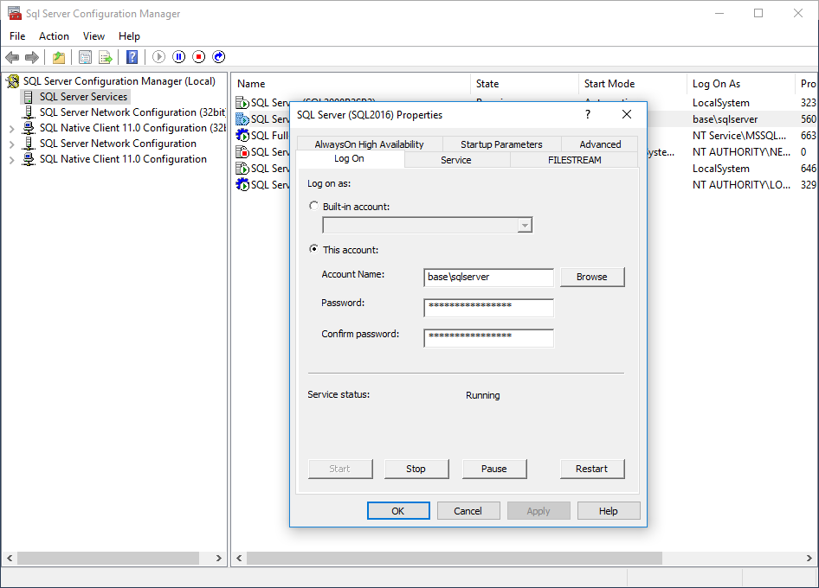
PowerShell ❤️ SQL Server
Developing for different SQL Server versions
No need to know underlying tables between versions
Performing tasks in SQL Server Configuration Manager
Notes:
Let’s talk about SMO

Slide 43

PowerShell ❤️ Windows
Performing related Windows administrative tasks
Certificate Management
Registry access
Active Directory
Service Principal Names (SPNs)
Event Viewer
Power Plans
Filesystem

Slide 44
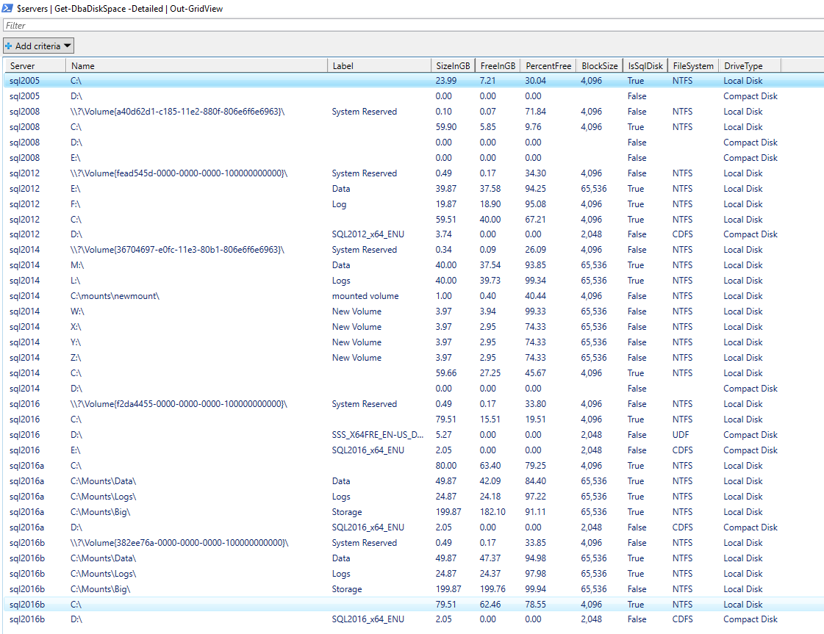
PowerShell ❤️ the Filesystem
Notes:
ASP.NET Hammer

Slide 45
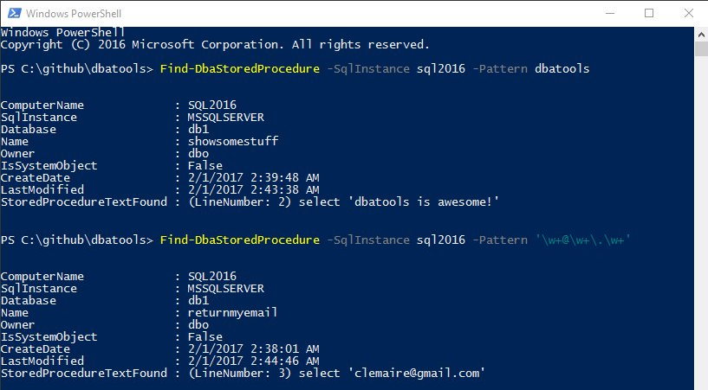
PowerShell ❤️ regex
Notes:
When you want the power of regex
More powerful and faster than LIKE
37,545 SQL Server stored procedures on 9 servers evaluated in 8.67 seconds!

Slide 46
PowerShell Remoting & Security
We’ve got great news
Notes:
https://www.youtube.com/watch?v=BIwe571zcWY
The Little JPEG that Could Hack Your Organization w Marcus Murray

Slide 47
PowerShell Remoting
Windows PowerShell supports remote computing by using various technologies, including WMI, SQL WMI, RPC, SSH & and WS-Management
Some commands require no remote configuration, including
Restart-Computer
Test-Connection
Get-HotFix
Get-Process
Get-Service
Get-WinEvent
Get-WmiObject
“Remoting” refers to commands that use WS-Management
Notes:
https://docs.microsoft.com/en-us/powershell/scripting/core-powershell/running-remote-commands?view=powershell-5.1

Slide 48
PowerShell Remoting (WS-Management)
Microsoft’s recommended way to manage Windows
By default, only allows connections from members of the Administrators group
Single port 5985 or 5986
Uses the Web Services for Management (WS-Management) protocol
Regardless of the transport protocol used (HTTP or HTTPS), PowerShell Remoting always encrypts all communication after initial authentication with a per-session AES-256 symmetric key
Initial authentication is NTLM, Kerberos and Certificates so no credentials are ever exposed
Notes:
https://docs.microsoft.com/en-us/powershell/scripting/setup/winrmsecurity?view=powershell-5.1
https://blogs.technet.microsoft.com/ashleymcglone/2016/06/29/whos-afraid-of-powershell-security
https://github.com/psconfeu/2017/tree/master/David%20das%20Neves/PSConfEU17_Security_Preconf
https://blogs.msdn.microsoft.com/daviddasneves/2017/05/25/powershell-security-at-enterprise-customers/
https://vimeo.com/17649459

Slide 49
PowerShell Security In-Depth
sqlps.io/owned
Notes:
See a dude own a DC thru jpg, sql server and a stolen token

Slide 50
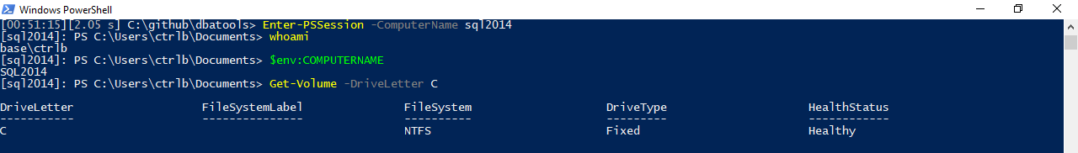
PowerShell Remoting
Notes:
Windows PowerShell supports remote computing by using various technologies, including WMI, RPC, and WS-Management.

Slide 51
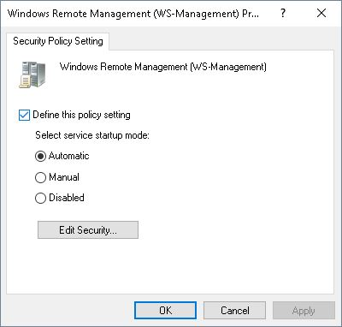
PowerShell Remoting
Enable-PSRemoting
winrm quickconfig
Via Group Policy Objects
Notes:
https://4sysops.com/archives/enable-powershell-remoting/

Slide 52
Remoting Setup
sqlps.io/remoting
Notes:
See a dude own a DC thru jpg, sql server and a stolen token

Slide 53


PowerShell Security

Slide 54
PowerShell Security
“Secure by Design”

Slide 55
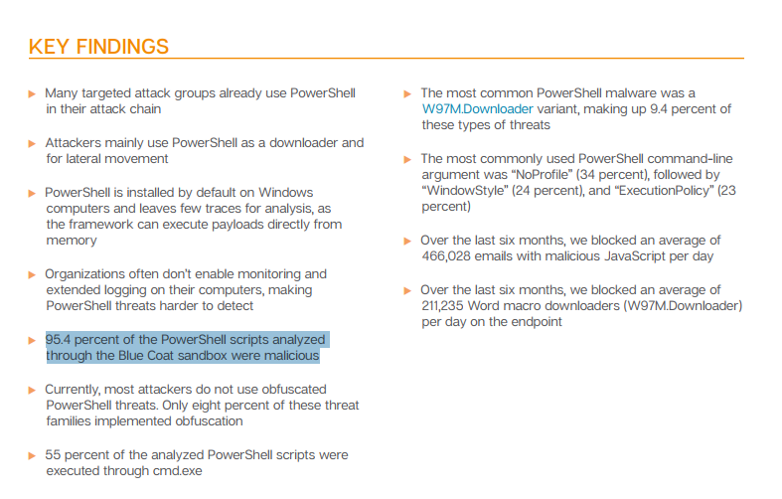
FUD in the Media
🙄
Notes:
https://www.symantec.com/connect/blogs/powershell-threats-surge-954-percent-analyzed-scripts-were-malicious

Slide 56
FUD in the Media
“AV, they love to talk about ransomeware attacks that use PowerShell, and the reason they do this is because they literally can’t keep up with the plain old stuff like exes. But they also do this because we as a community encourage it. We blog it, we tweet about it, we talk about it. And the next thing you hear is that there’s a PowerShell problem. They don’t seem to ask how to solve their C++ problem or their darn x64 problem.” ~ Lee Holmes, DerbyCon 2016 Keynote
Notes:
https://www.youtube.com/watch?v=BMreZZ1cgFI
https://docs.microsoft.com/en-us/powershell/scripting/setup/winrmsecurity?view=powershell-5.1
https://blogs.technet.microsoft.com/ashleymcglone/2016/06/29/whos-afraid-of-powershell-security
https://github.com/psconfeu/2017/tree/master/David%20das%20Neves/PSConfEU17_Security_Preconf
https://blogs.msdn.microsoft.com/daviddasneves/2017/05/25/powershell-security-at-enterprise-customers/

Slide 57
Context
”When security researchers leverage PowerShell, it is always in a post-compromise context. They have compromised a machine through some other avenue (phishing, SQL injection, etc.), and ultimately have the choice of any number of tools on the system. They were able to accomplish their goals before PowerShell, and will be able to accomplish their goals without PowerShell.”
~ Lee Holmes, Principal Security Architect
Notes:
https://blogs.msdn.microsoft.com/powershell/2016/09/27/powershell-security-at-derbycon/

Slide 58
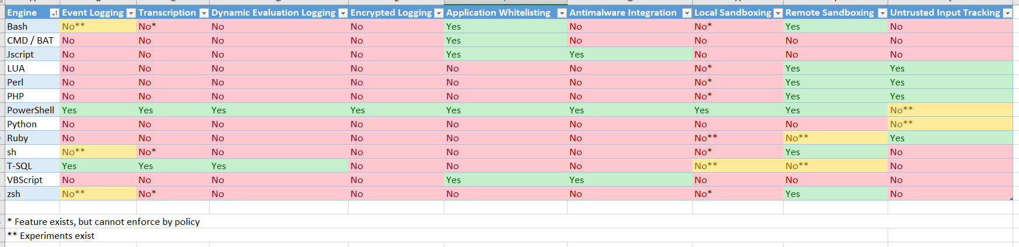
Logging
Notes:
https://blogs.msdn.microsoft.com/powershell/2017/04/10/a-comparison-of-shell-and-scripting-language-security/
Event Logging – The engine logs audit events of important operational events.
Transcription – The engine logs application inputs and outputs.
Dynamic Evaluation Logging – The engine logs the content of all content evaluation, including those generated or composed at runtime.
Application Whitelisting – The engine allows enforcement of code integrity / application whitelisting policies, including user-authored documents / scripts.
Antimalware Integration – The engine actively integrates with antimalware software to evaluate the safety of code generated at runtime.
Local Sandboxing – The engine allows sandboxing of behavior for local and interactive use.
Remote Sandboxing – The engine allows sandboxing of behavior when accessed remotely.
Untrusted Input Tracking – The engine allows script developers to track and make security decisions based on whether a variable or input was influenced by user input.

Slide 59
PowerShell Security In-Depth
sqlps.io/secure
Notes:
“The security argument for PowerShell is not that it's impenetrable, but that the API is designed with security in mind, and the PowerShell team itself has an impressive turnaround time when it comes to mitigating vulnerabilities. Ultimately, a quick and measured response is better than believing in total security.”
~ Mathias Jessen, @iisresetme

Slide 60

SQL Server
Pester
❤️

Slide 61
TODAY’s TO DO LIST
GET UP
Drink Appropriate Liquid
The Rest

Slide 62
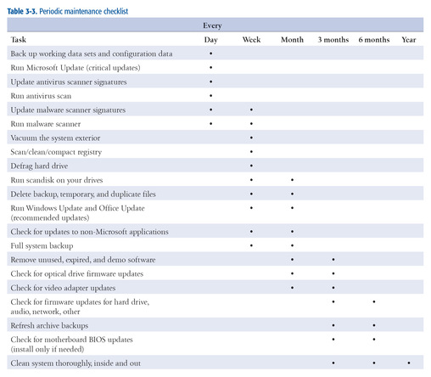
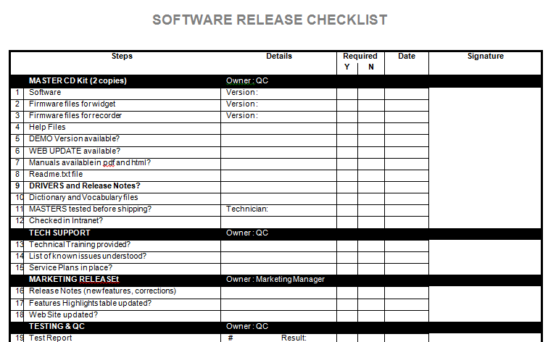
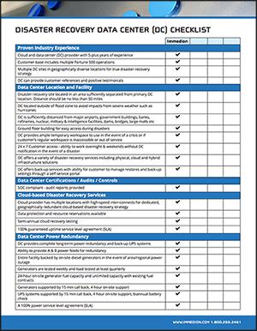
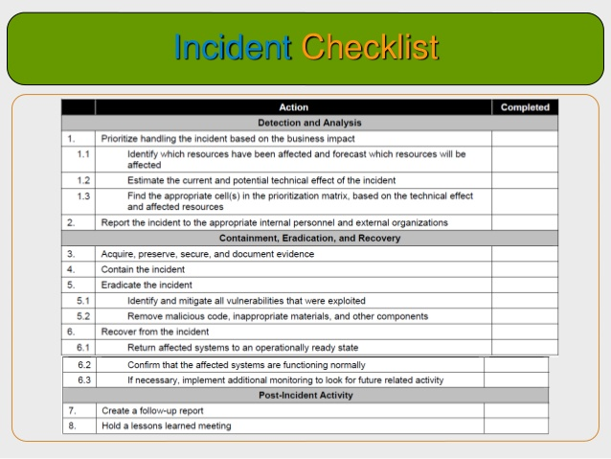
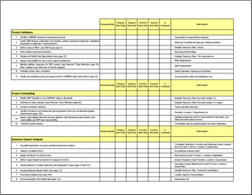
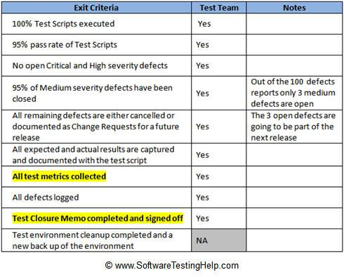
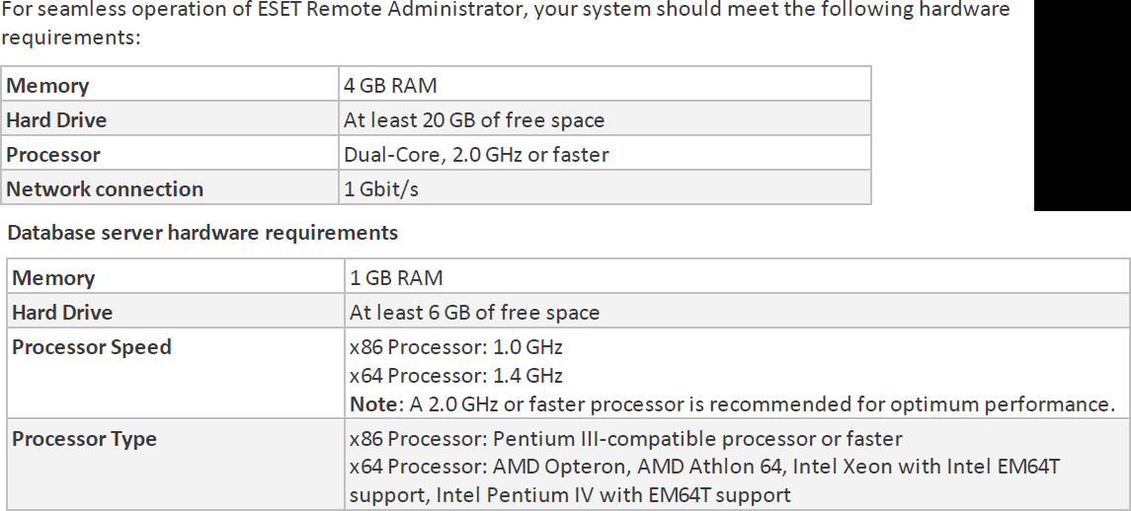
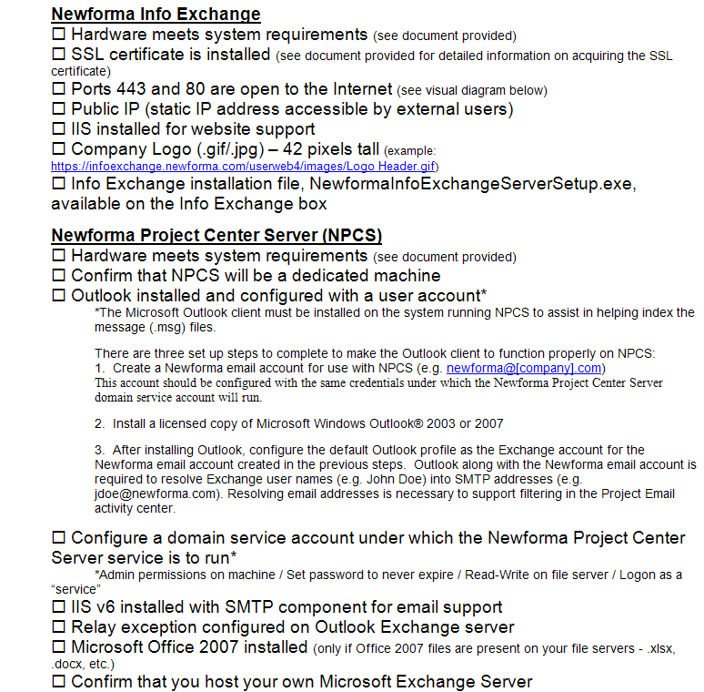
How many checklists do you have?
Notes:
I bet there are checklists for
New servers/ data centers
Hardware/software installations
Incident Response
1st Line/2nd line for systems
Pre-requisites
Morning routines

Slide 63
What about
Demos
Presentations
Morning Checks
Incident Response
First Line Support
I‘m sure you are already thinking of more

Slide 64
What is Pester?
Pester provides a framework for running unit tests to execute and validate PowerShell commands from within PowerShell
sqlps.io/pester
Notes:
Its used for unit testing or TDD but can also be used to validate an environment.
Comes with Windows 10 or install from the gallery with Install-Module Pester

Slide 65
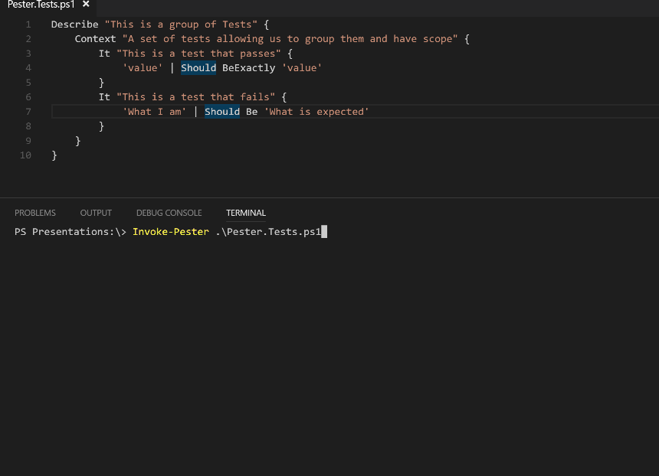
What Does Pester Look Like?
Notes:
This is a Pester test running in VS Code

Slide 66

Apologies. Forgive Me!

Slide 67
Should Operators
Be Compares one object with another for equality. Case Insensitive BeExactly Compares one object with another for equality. Case Sensitive BeGreaterThan Asserts that a number is greater than an expected value. BeLessThan Asserts that a number is less than an expected value. BeLike Asserts that the actual value matches a wildcard pattern using -like operator. Case Insensitive BeLikeExactly Asserts that the actual value matches a wildcard pattern using -like operator. Case Sensitive BeOfType Asserts that the actual value should be an object of a specified type Exist Does not perform any comparison but checks if the object calling Exist is present in a PS Provider. Contain Checks to see if a file contains the specified text. Case Insensitive ContainExactly Checks to see if a file contains the specified text. Case Sensitive Match Uses a regular expression to compare two objects. Case Insensitive MatchExactly Uses a regular expression to compare two objects. Case Sensitive Throw Checks if an exception was thrown in the input ScriptBlock. BeNullOrEmpty Checks values for null or empty (strings).
I hate slides with lots of text but I think this one is valid
Notes:
For you to use in the future – The important one to remember is the contains

Slide 68

So what can you validate ?
Notes:
Everything in the world ☺

Slide 69
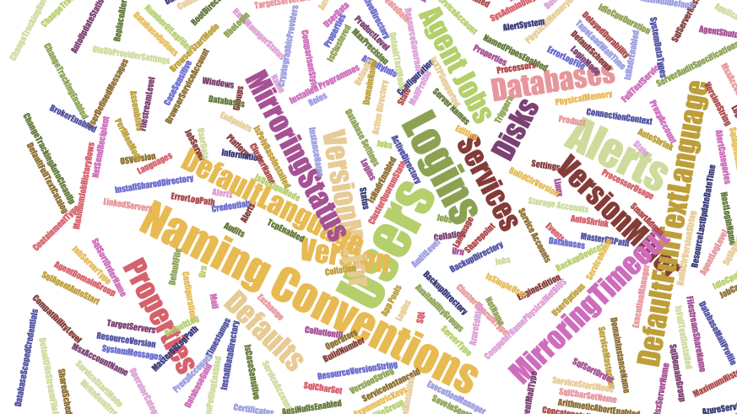
Maybe not EVERYthing!
but anything you can validate with PowerShell
Notes:
These are just some of the properties of
A SQL Server SMO object,
A Job Server object and
A database object
There are (for SQL Server 2017
113 properties on a SQL Server Instance object
75 on a Configuration object
184 properties ona Database object
47 on a Job Server object
40 on a Job Object
AND That’s just SQL Server – Files, Operating System, Active Directory etc etc etc

Slide 70
Maybe not EVERYTHING – Part 2
Which Does NOT include
Describe “Bag Packing” {
Context “Hardware”{
It “Bag Should include BeardNUC” {
$bag.Contents –contains ‘beardnuc’| Should Be $True
}
}
}
I had no virtual machines with me Queue demo re-write until 3am!
Notes:
Whilst this is a funny slide there is an important piece of Pester knowledge here
This is the correct way to test if an array contains a value

Slide 71

Hey Beardy!
DEMO
Time

Slide 72
Summary
We all have checklists – manual testing is error-prone
Pester is a Unit Testing Framework for PowerShell
You can use it to validate your infrastructure
The basic syntax - Describe, Context and It code blocks
The Should command is used for testing assertions
Use the NunitXML output, export to JSON and use PowerBi for fantastic reports or to be consumed in your CI/CD process

Slide 73

Before Lunch
If you didn’t meet the pre-reqs, please enter your email at sqlps.io/signup for Azure access to a lab
Somewhat limited number. First msg’d, first served

Slide 74

Lunch

Slide 75
Enjoyed Lunch?
If you need help with any setup ask a proctor or in the dedicated Slack channel
sqlps.io/azurelab
Notes:
FileSystem::\\UNC

Slide 76
dbatools
the community module
Notes:
Intro to dbatools

Slide 77
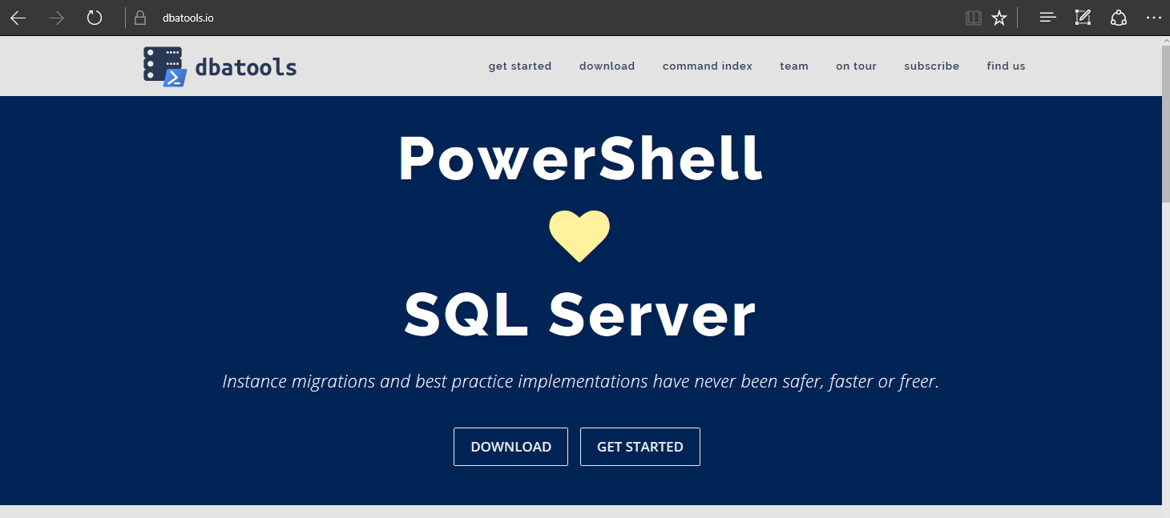
dbatools

Slide 78
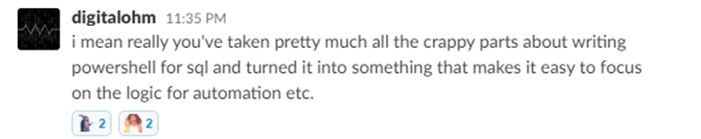
Basically..

Slide 79
Support
SQL Server 2000 – vNext
Express – Enterprise Edition
Clustered and stand-alone instances
Windows and SQL authentication
Default and named instances
Multiple instances on one server

Slide 80
System Requirements
MINIMUM
RECOMMENDED
Client
PowerShell v3
Server
SQL Server 2000
No PowerShell for pure SQL commands
PowerShell v2 for Windows commands
Remote PowerShell enabled for Windows commands
Client
PowerShell v5.1
Server
SQL Server 2008 R2+
Notes:
SQL Server 2000 – think “Can SSMS connect?”

Slide 81
Install is easy
POWERSHELL GALLERY
Install-Module dbatools
Install-Module dbatools –Scope CurrentUser
GITHUB
Invoke-Expression (Invoke-WebRequest dbatools.io/in)
WEBSITE
dbatools.io/download

Slide 82
Need an offline install?
GET THE ZIP
dbatools.io/zip
INSTALL TO YOUR $env:PSMODULEPATH
By default at
$home\Documents\WindowsPowerShell\Modules
$env:SystemDrive\Program Files\WindowsPowerShell\Modules

Slide 83
Need an offline install?
dbatools.io/offline

Slide 84
Now, to Import
After installing, you must import the module
Import-Module dbatools
Module manifest vs. Script module
psd1 – module manifest
formal, explicit
psm1
more informal, all functions are imported
Notes:
Speaking of functions!

Slide 85

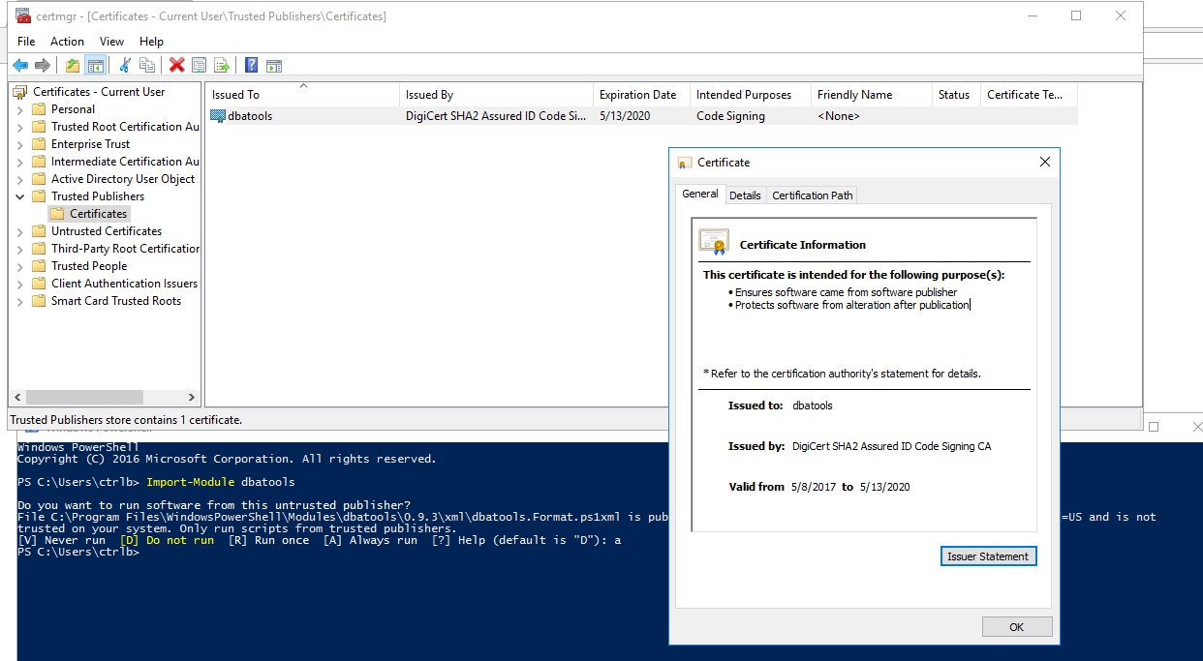
dbatools is digitally signed

Slide 86
Set-ExecutionPolicy
“Execution Policy is not a security control and should not be treated as one. The security control is Application Whitelisting (AppLocker / Device Guard)” ~ PowerShell Team
“It's important to understand that the setting was never meant to be a security control. Instead, it was intended to prevent administrators from shooting themselves in the foot.” ~ Scott Sutherland, author of PowerUpSQL
Notes:
https://blog.netspi.com/15-ways-to-bypass-the-powershell-execution-policy
https://www.darkoperator.com/blog/2013/3/5/powershell-basics-execution-policy-part-1.html
https://blogs.msdn.microsoft.com/powershell/2008/09/30/powershells-security-guiding-principles/
“ExecutionPolicy is like a baby door. The ExecutionPolicy keeps babies safe but every grown-up passes it easily.” ~ David das Neves, Microsoft PFE

Slide 87
For more information
dbatools.io/fullinstall

Slide 88
How to Get-Help
Extensive documentation within each command
Get-Help Start-DbaMigration -Detailed
Extensive documentation on dbatools.io
dbatools.io/Test-DbaLastBackup dbatools.io/Set-DbaSpn
Some commands have videos
dbatools.io/youtube

Slide 89
dbatools vs SqlServer
SqlServer is officially supported by Microsoft
SqlServer is C# cmdlet based
SqlServer is closed-source & must be fixed and enhanced by Microsoft
SqlServer has fewer resources
dbatools has unofficial, community-based support
dbatools is PowerShell function based
dbatools is open source – fix or enhance yourself or ask us
dbatools has 80+ contributors

Slide 90
demo time!

Slide 91

docker lab!

Slide 92
PowerShell & SQL Agent

Slide 93
PowerShell & the SQL Server Agent
PowerShell Job Step
sqlps.exe
Version varies by SQL Server version
Doesn’t always work as expected
CmdExec Job Step
powershell.exe via cmd.exe
Version is always the system version
Often (always?) works as expected
Notes:
FileSystem::\\UNC

Slide 94
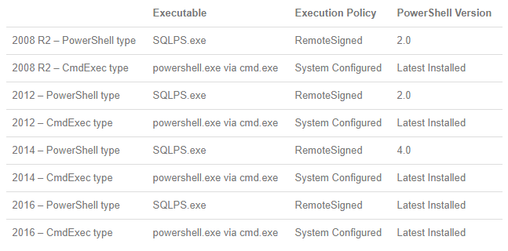
PowerShell & the SQL Server Agent
Thanks to Derik Hammer for this chart!
Notes:
https://www.sqlhammer.com/running-powershell-in-a-sql-agent-job/

Slide 95
PowerShell & the SQL Server Agent
Create a Windows-based Login in SQL Server
Ensure dbatools is available to the account
Create a SQL Server credential
Create the Agent Proxy
Create the PowerShell .ps1 file
Create the Job and Job Step
Schedule the Job

Slide 96
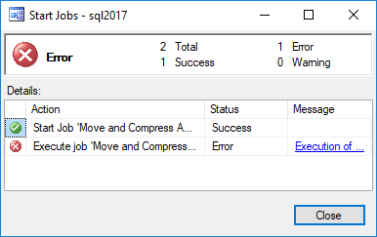
Ensure failed jobs fail
To ensure a job fails, throw a terminating exception
In dbatools, use –EnableException
In most PowerShell commands, use try/catch with –ErrorAction Stop

Slide 97
PowerShell & the SQL Server Agent
dbatools.io/agent

Slide 98
dbatools development in practice
the story of Get-DbaRestoreHistory

Slide 99
Development agenda
Get-Inspired
Grab a template
Get to v1
Add a test or two
Create a pull request on GitHub
Notes:
dbatools.io/testing

Slide 100
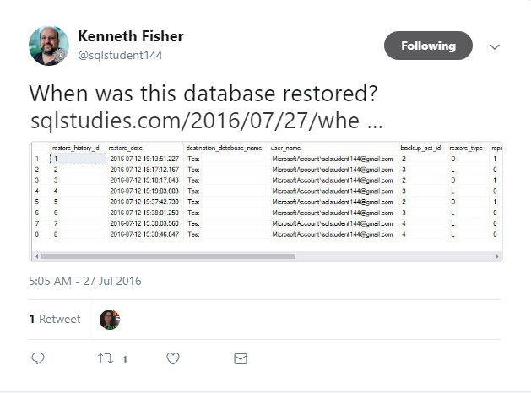
Get-Inspired
Notes:
https://sqlstudies.com/2016/07/27/when-was-this-database-restored/

Slide 101
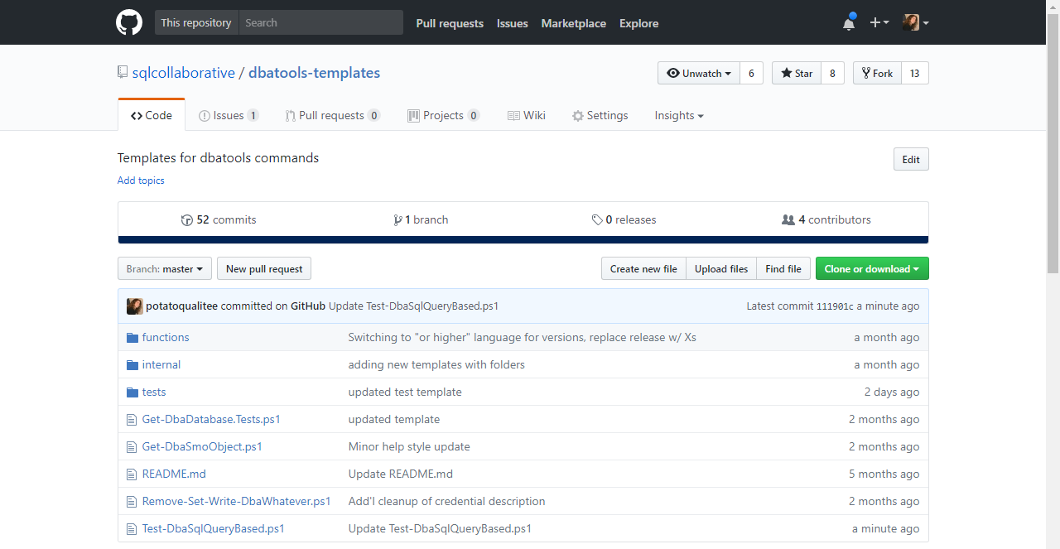
Grab a template
Notes:
dbatools.io/templates

Slide 102

Pester tests
Notes:
dbatools.io/testing

Slide 103

GitHub
Notes:
dbatools.io/testing

Slide 104
demo time!

Slide 105
GitHub tutorial
dbatools.io/firstpull

Slide 106
lessons learned
Notes:
CK –
Getting everyone onto one platform matters if you want useful support
Useful documentation is as good or better than a command (because no one reads the source code, or finds it confusing, many find dbatools a black box)
Should have studied my role a bit more, there’s even more to the git world outside of what the dbatools project does, and literally 10-15 minutes of reading each time has yielded insanely good time returns.
We probably should have done a little more delegation of work for Chrissy, she does too much still today.
I wish I knew about the about_ help documents.
I wish I knew about Get-Member earlier.
I wish I knew I didn’t need to use multiline powershell quotes since double quote works just fine? All the docs I read said otherwise.
I wish someone slapped the keyboard out of my hands when I kept trying to do everything like I did in bash
I wish I met most of these people earlier in my career so I would be even further than I am today.

Slide 107
Lessons learned
Don’t try to put everything in one big .ps1
With each mini-project, start with base commands – Get, Set, New, Remove
Include Pester tests from the beginning
Standardize naming from the beginning, including prefix
Use source control
Don’t rely on parsing English – “hohe Leistung”
Notes:
Source control - Not just because it’s pragmatic, but also because ultimately, it’ll save you so much time. No more .old, .old2, .testtryingagain. Also, accountability. You can see who did what when.

Slide 108
Lessons learned
Don’t bother with PowerShell Agent Job Step
Create great docs from the start
Use a template for repeated parameters
Use June Blender’s Pester tests for Help
Code doesn’t need to be 1.0 for PowerShell Gallery

Slide 109
Questions!

Slide 111
Bonus slides

Slide 112
The PowerShell Security Argument
“The security argument for PowerShell is not that it's impenetrable, but that the API is designed with security in mind, and the PowerShell team itself has an impressive turnaround time when it comes to mitigating vulnerabilities. Ultimately, a quick and measured response is better than believing in total security.”
~ Mathias Jessen, @iisresetme
Notes:
https://docs.microsoft.com/en-us/powershell/scripting/setup/winrmsecurity?view=powershell-5.1
https://blogs.technet.microsoft.com/ashleymcglone/2016/06/29/whos-afraid-of-powershell-security
https://github.com/psconfeu/2017/tree/master/David%20das%20Neves/PSConfEU17_Security_Preconf
https://blogs.msdn.microsoft.com/daviddasneves/2017/05/25/powershell-security-at-enterprise-customers/

Slide 113
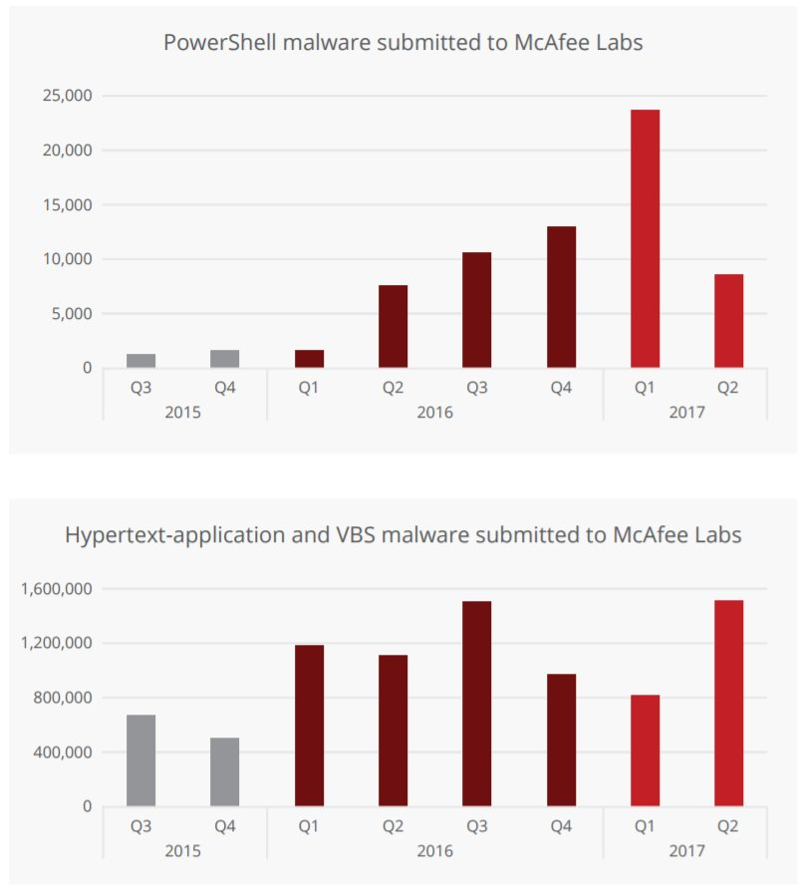
PowerShell Security – VBS 100x

Slide 114
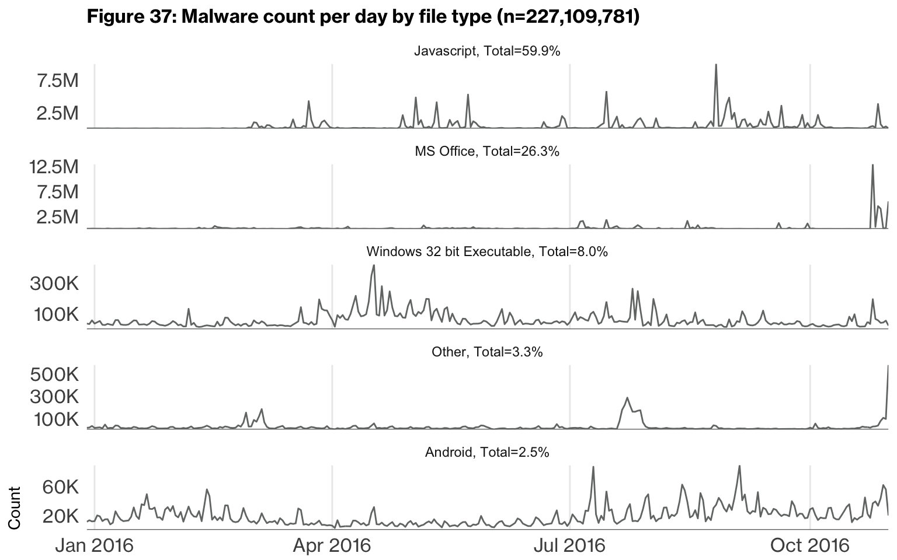
PowerShell Security

Slide 115
SqlServer
The Official Module

Slide 116
SqlServer Recap
SQL Server 2016, 2017 and Beyond
A new name
Now separate from SSMS install
PowerShell Gallery
All-grown up
Continuous releases
Currently at 98 cmdlets
Notes:
Toy Story Reference ☺
The SQL Server team hired a dedicated PowerShell engineer – We love Matteo – even if we aren’t sure how to pronounce his surname
Microsoft began taking Connect Items (suggestions + bug reports) seriously
https://social.msdn.microsoft.com/Forums/en-US/728f562f-0600-432b-aaab-1decc406d6d8/submitting-defect-reports-and-suggestions?forum=sqltools
SQLPS was renamed to SqlServer
Made it easier to do REGULAR RELEASES!
Initially these were monthly releases associated with SSMS
But then they were doing two a month of SSMS
March 2017 - Separated from SSMS install with the SSMS 17.0 release and available from the PowerShell Gallery – no need for massive download (20Mb versus 700Mb ) and quicker releases –easier to update

Slide 117
System Requirements
MINIMUM
Client
PowerShell v5
Server
SQL Server 2000
PowerShell not required
Notes:
Think “Can SSMS connect to this (SQL Server 2000)?” If yes, then it’ll also work with “command line SSMS”
No Windows-related commands exist! So PowerShell is not required

Slide 118
Installation and Update
POWERSHELL GALLERY
Install
Install-Module SqlServer
Install-Module SqlServer –Scope CurrentUser
In some circumstances you will have to use the –AllowClobber switch
Update
Update-Module SqlServer
Notes:
SSAS so that’s why AllowClobber

Slide 119
Commands
Awesome
Could Do Better
There are commands for
Availability Groups
Always Encrypted
SSAS
Credentials
Logins*
Backup/Restore*
Help
Tab Completion
Errors for Not Found
Get-* = Set-*
Users
Create a Database
Only 98 Commands
Notes:
Cmdlets vs functiosn
Availability Groups and Always Encrypted are well served with SqlServer module
There are some commands for administering SSAS and credentials
One simple Backup and One Simple restore command (just wait there's more on that to come ☺ )
Logins but not users!
Dbatools does help MUCH better
Dbatools does tab completion MUCH Better
An Error when you don’t find a login with Get- This is confusing
You can Set Authentication Mode but not get it
Why can I not create a database or a user ? – We know why – There is only one Matteo!

Slide 120
SQLSERVER:\ - The Provider
You can explore SQL Server at the command line as if it was a file system
You can use dir, ls, gci
Useful for answering quick questions or first stage of incident resolution

Slide 121
Demo Time!

Slide 122
Housecleaning
Import-Module psd1 vs psm1

Slide 123
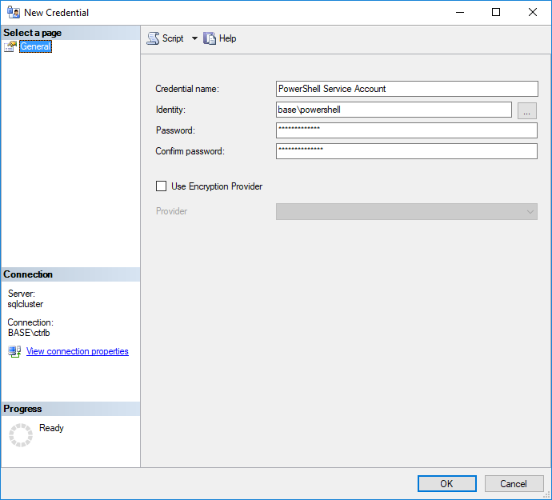
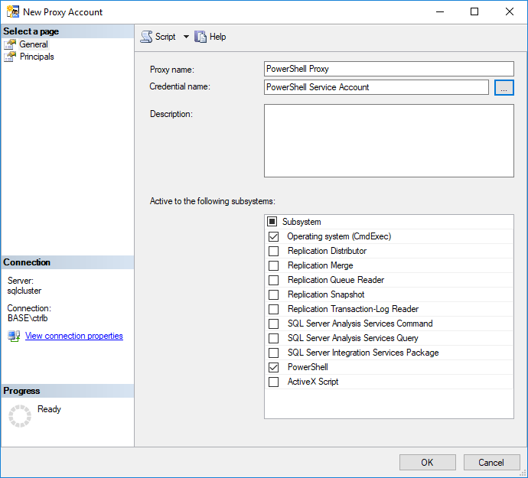
PowerShell & the SQL Server Agent

Slide 124
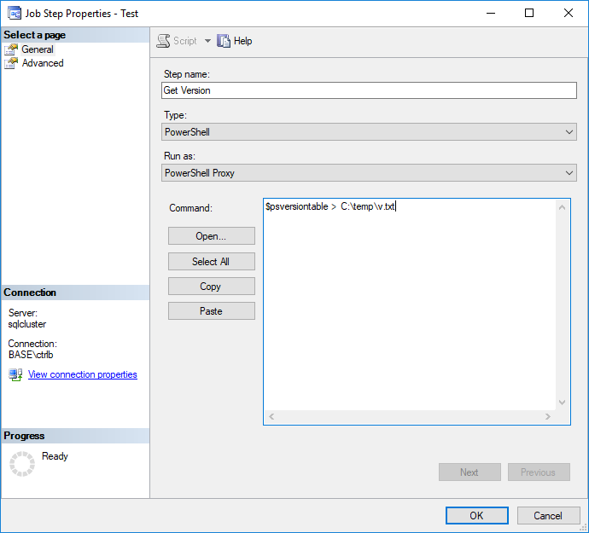
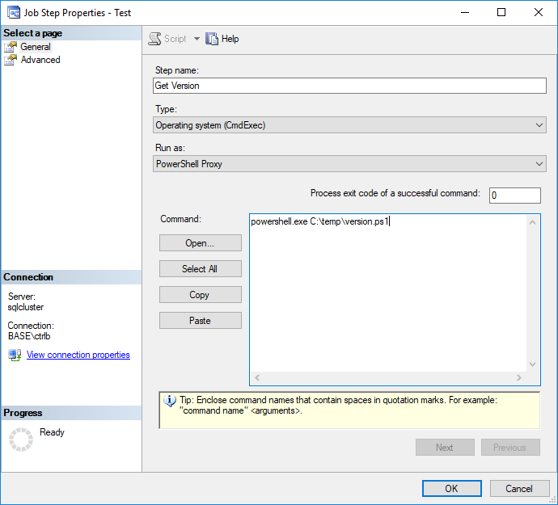
PowerShell & the SQL Server Agent

Slide 125
Where-Object
Two modes
-Property
-Value
-FilterScript {ScriptBlock}
Notes:
Technically Where-Object has two modes, one with a basic Property/Value match (no ands or ors) and one with a -FilterScript
I generally avoid the first mode because you just have to switch to the second if you want to make it more specific, and Filterscript allows you to also make dynamic compound values, which is cool.
A pretty skint slide, let’s move onto the operators.

Slide 126
Group-Object Parameters
-Property
-AsHashTable
-AsString
-CaseSensitive
-Culture
-InputObject
-NoElement
Notes:
Group-Object has a few useful parameters, but I mostly stick to the defaults and avoid all of them, that said, let’s quickly dive in.
-Property One or more properties or scriptblocks you would like to group on. (Default)
-AsHashTable Skip the count and just return a @{ Name, Value} pair of grouping/items, most useful for returning json imo
-AsString Convert the Group items into strings, useful for presentation without further munging/expanding.
-CaseSensitive By default grouping is not case sensitive.
-Culture The culture to use when comparing strings, this is very useful when you are not comparing strings from your locale.
-InputObject Be aware that if you submit a collection via this Group-Object will only see one, so this is mostly carp.
-NoElement Do not return the elements of the group in the results, .

Slide 127
Sort-Object Parameters
-Property
-CaseSensitive
-Culture
-Descending
-Unique
-InputObject
Notes:
Sort-Object maps your default output value to the property field, which you can explicitly call out, or even list multiple.
By default, Sort will check for default properties, if it does not exist it will interpret it as $null and place it at the end of the sort order
If the property itself isn’t compareable, sort-object will actually convert it to a string to compare it.
If you sort on a property that is an enum, it will sort the enumeration in numeric order, even while translating the value to the “human readable” form.
By default sort-object is not case sensitive
By default, sort-object usese your culture
By default, sort-object uses asc order
The param I wanted to talk for a minute about is the unique param which is a “unique” param, in that it somewhat defies expectations from our T-SQL world. (Haha pun!)
Basically, it will use the property you are selecting as the bucket for unique values, and scan through your items taking any value it hasn’t already seen.
Unlike the GROUP BY/DISTINCT rules we are used to, its good to know PowerShell uses a first come first serve attitude.
Whew!
So we got through the basic mapping of PowerShell commands to T-SQL functions, what’s left? Well, some odd behavior, that’s what.

